Slide 1

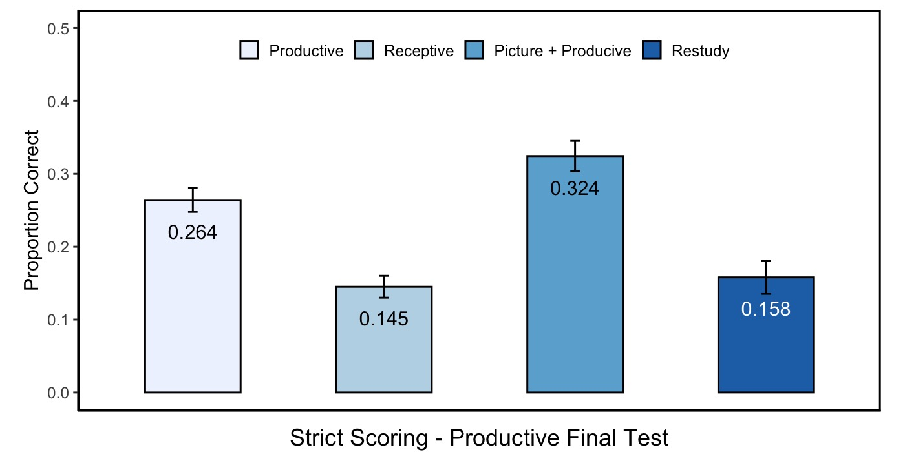
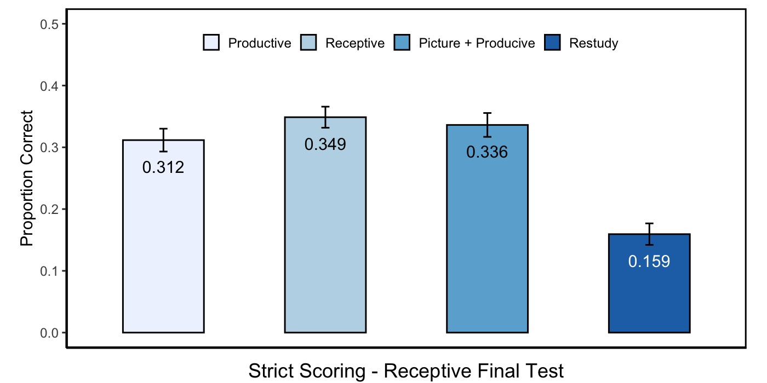
What is the most effective second-language vocabulary learning method?
Jason H. Moy¹; Timothy C. Rickard¹
¹University of California, San Diego
Introduction
Methods and Materials
Results
Past research suggested training in a test format is better than restudy control (e.g. Carrier & Pashler, 1992). However, no one had empirically tested whether the theory applied in learning second language vocabulary
Past research suggested training productively (or receptively) lead to substantial receptive (or productive) knowledge (e.g. Mondria & Wiersma, 2004; Griffin & Harley, 1996). Their argument was based on the finding that people were able to recall some target words when they were trained receptively but tested productively, or vice versa. Since the participants did not know any of the target words prior to the study, any knowledge of the target word must come from the training itself. However, their evidence is not sufficient to support that argument since it is possible the mere exposure to the word pair, instead of training, made participants learned the words. Therefore, it is necessary to compare the training condition with a restudy control to determine whether their argument is correct or not.
In the present study, we also added a picture + productive training condition. This is motivated by the dual coding theory (Clark & Paivio, 1991; Reed, 2012). Dual coding theory dictate that there are two systems in memory, one specialized in coding non-verbal object information (e.g. picture), the other specialized in coding verbal object information (e.g. words). The two systems function independently, meaning that a person can forget one code without forgetting the other. Therefore, if we allow people to code the target words using both systems, it may have higher retention rate than coding using only one system.
Participants:
103 Chinese undergraduate student at UCSD
Material:
48 English terms were selected from a GRE vocabulary book
Those terms were translated into Chinese using the Oxford English-Chinese Dictionary
Procedure:
In the initial study phase, participants saw the Chinese and English words together to familiar with all the word pairs
In the training phase, participants will train in 4 different methods (productive, receptive, picture + productive, restudy)
Productive (Chinese → English); Receptive (English → Chinese); Picture + Productive (Chinese + Picture → English)
After 48 hours, participants return to take either the productive or the receptive final test
Initial Study Phase
48-word pairs
Productive
Training
12-word pairs
Receptive
Training
12-word pairs
Productive + Picture
12-word pairs
Restudy
Training
12-word pairs
Discussion & Future Direction
Objective
Retention rate is higher for training utilizing test format than restudy control.
Participants gain receptive knowledge from productive training, but we have no evidence that they gain productive knowledge from receptive training.
Adding a pictorial cue to productive training may be beneficial compared to productive training alone.
Future study may want to examine whether adding more cues (e.g. sound) will also be beneficial.
Investigate whether retention rate is higher using test-format training compared to restudy control
Investigate whether training in a reversed testing format compared to the final test (e.g. productive training on a receptive final test) may remain beneficial compared to restudy control
Investigate whether adding a picture to productive training condition is better than productive training alone.
Productive or Receptive
Final Test
48-word pairs
References
Carrier, M., & Pashler, H. (1992). The influence of retrieval on retention. Memory & Cognition, 20(6), 633–642. https://doi.org/10.3758/BF03202713
Clark, J. M., & Paivio, A. (1991). Dual coding theory and education. Educational Psychology Review, 3(3), 149–210. https://doi.org/10.1007/BF01320076
Griffin, G., & Harley, T. A. (1996). List learning of second language vocabulary. Applied Psycholinguistics, 17(4), 443–460. https://doi.org/10.1017/s0142716400008195
Mondria, J. A., & Wiersma, B. (2004). Receptive, productive, and receptive + productive L2 vocabulary learning: what difference does it make? In P. Bogaards & B. Laufer-Dvorkin (Eds.), Vocabulary in a second language: Selection, acquisition, and testing, (pp. 79–100). https://doi.org/10.1075/lllt.10.08mon
Reed, S. K. (2012). Cognition: Theories and Applications. CENGAGE learning.

